Slide 1

Comparative Analysis of Automated US Housing Valuation Models
OLS, LASSO, XGBoost
D200 Machine Learning in Economics
Presenter: Jingrui LI — jl2543
Date: 25 March, 2026

Slide 2
Motivation & Research Question
■
Housing valuation is an important economic topic within the financial systems.
■
House prices show great heterogeneity across regions and various property characteristics
KEY QUESTION
■
By using coarse-grained location data and observable property characteristics, can machine learning improve housing price prediction relative to linear benchmark models?

Slide 3
Dataset and Variables
■
Dataset: U.S. real estate housing dataset on Kaggle
■
Numerical features: bed, bath, house_size, acre_lot
■
Observation: 1.47 million observations
■
Location features: city, state, area_type
■
Target variable: price (after log transformation)
■
Limitation: relatively coarse-grained data
Link for the dataset: https://www.kaggle.com/datasets/yasirumanujith/usa-real-estate-dataset

Slide 4
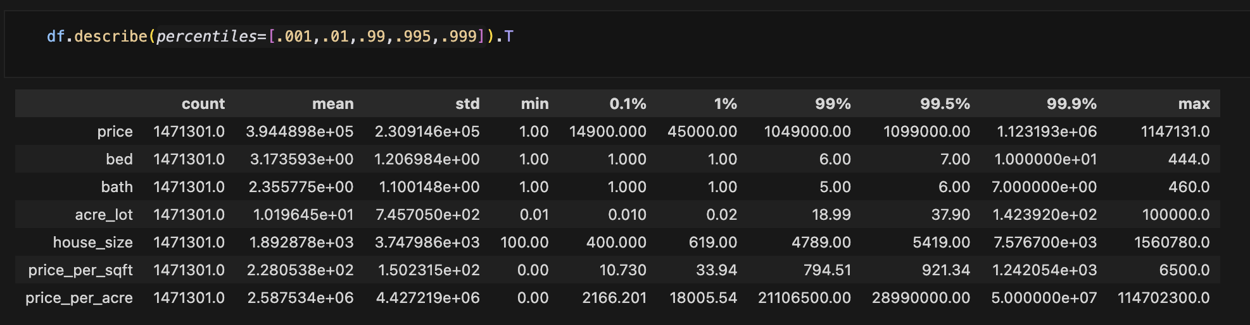
Exploratory Data Analysis and Wrangling
■
Dropped implausible observations with price <$10,000
■
Winsorized continuous variables at 1st and 99th percentiles, bed and bath capped at 10 and 7, respectively
■
Group infrequent “State” and “City” into ”other” category
■
Applied log transformation to price and selected continuous variables

Slide 5
Models and Implementation (1)
■
Data split into Trainval set and Test set by 80/20
■
Trainval set acts as the training set for OLS and LASSO
■
Categorical variables are one-hot encoded for LASSO and XGBoost, numerical variables are left without unchanged
■
LASSO Tuning: Alpha is tuned by a 3-fold cross-validation

Slide 6
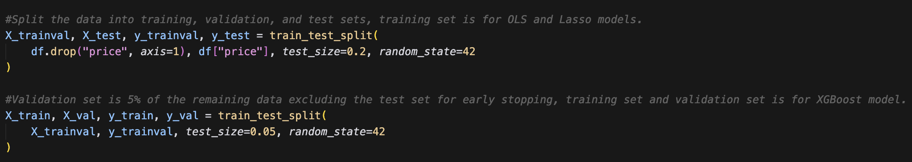
Models and Implementation (2)
■
Trainval set further split into Train set and Validation set by 95/05 for early stopping in XGBoost.
■
XGBoost: nonlinear tree-based model that captures interactions and nonlinearities
■
Hyperparameters Tuning: hyperparameters are tuned by 3-fold cross-validation on a random subsample (500,000 observations) for computational efficiency
■
Ater tuning, the model is retrained on the whole Train set
■
Early Stopping: early stopping rounds of 50 is applied using the validation set to prevent from overfitting

Slide 7
Model Evaluation
Model | RMSE | MAE | R²
OLS | 0.4293 | 0.3151 | 0.5740
LASSO | 0.4308 | 0.3165 | 0.5710
XGBoost | 0.3791 | 0.2724 | 0.6678
■
Metrics: RMSE, MAE, and R^2 are used to evaluate the model performance
■
XGBoost: clearly outperforms both linear models
■
LASSO: does not improve on OLS

Slide 8
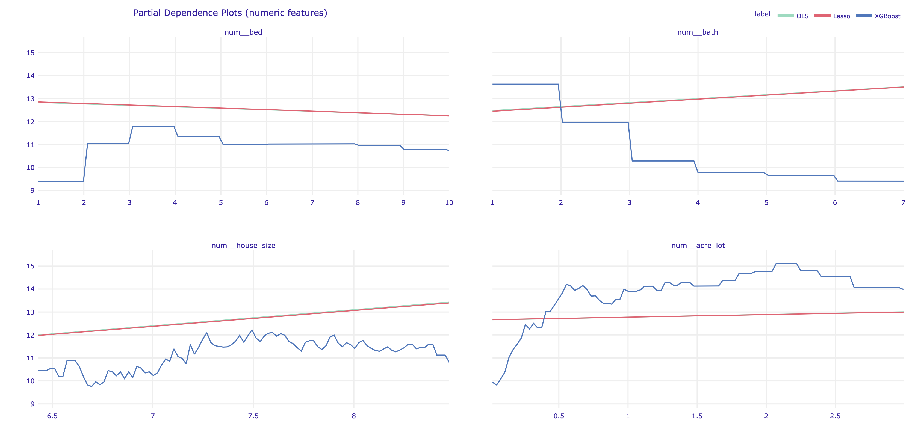
Why XGBoost wins: PDP shows nonlinear effects
■
Impacts of numerical variables on house price demonstrate strong nonlinearity
■
XGBoost performance elevation due to capacity to capture nonlinear characteristics

Slide 9
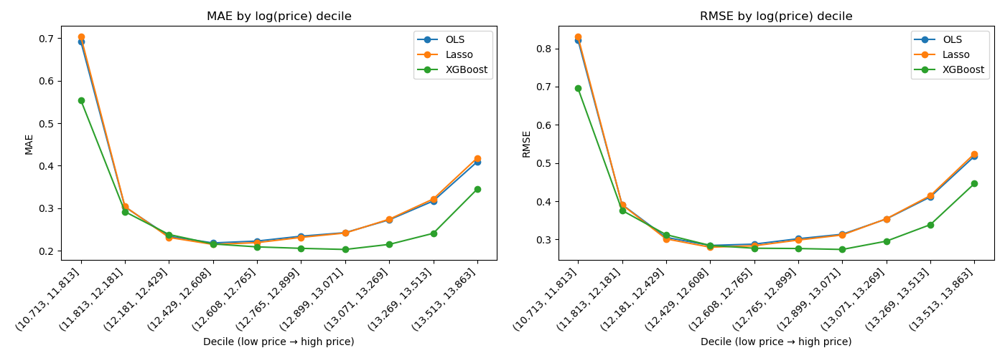
Errors are large at ends of price distribution
■
Mid range house prices are much easier to predict
■
Predictions errors are larger at both tails of the price distribution
■
Highly predictable variables are missing: crime rate, community quality, school district, etc.

Slide 10
Conclusion and Next Steps
■
XGBoost provides the best predictive performance
■
Housing prices exhibit important nonlinearities and spatial heterogeneity (Appendix 1)
■
LASSO does not improve over OLS in this setting
■
Challenge: Low price and High price houses are difficult to predict using coarse-grained data
■
If time permitting:
Add variables with richer information like crime rate, community quality , school district, etc.
Explore other models like random forest or neural network

Slide 11
THANK YOU

Slide 12
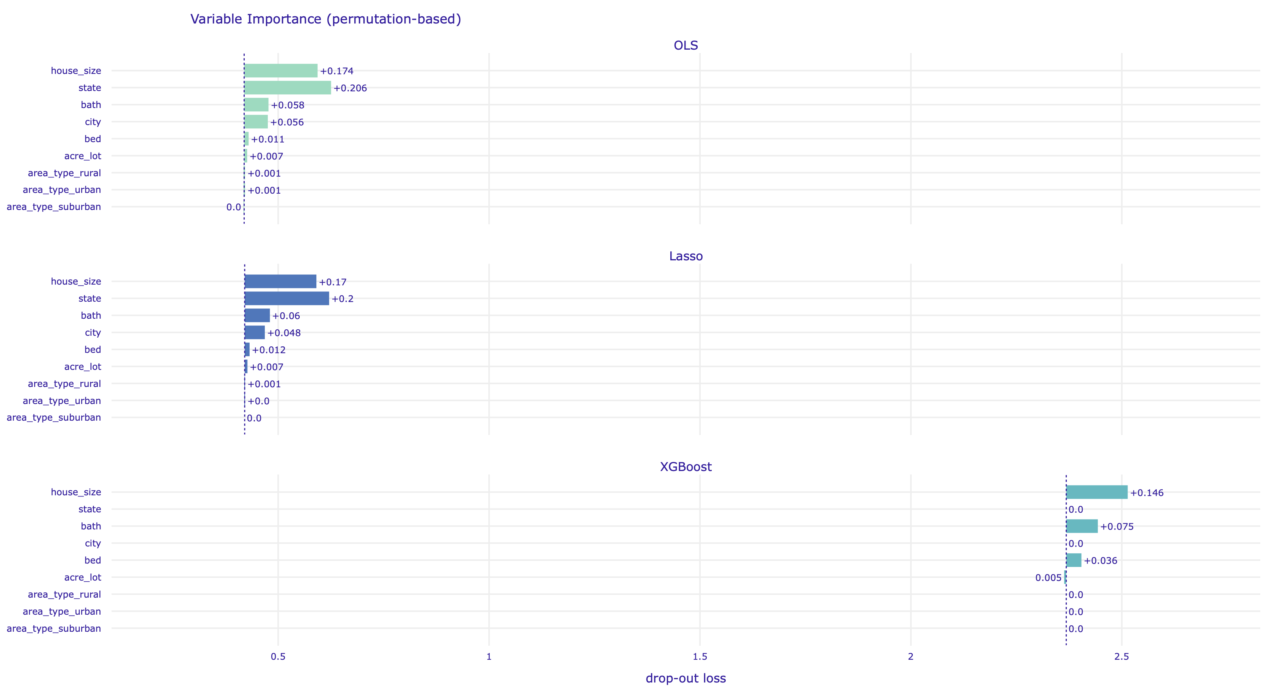
Appendix 1: Variable Importance

Slide 13
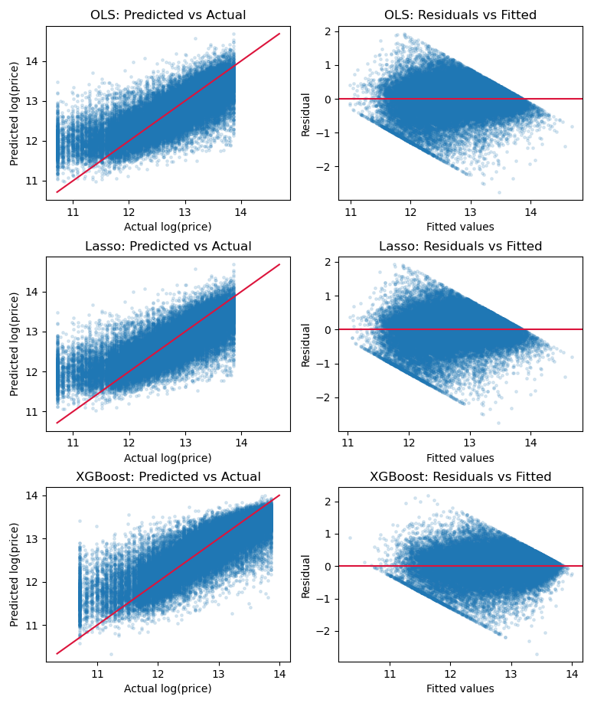
Appendix 2: Model Fitness

Slide 14
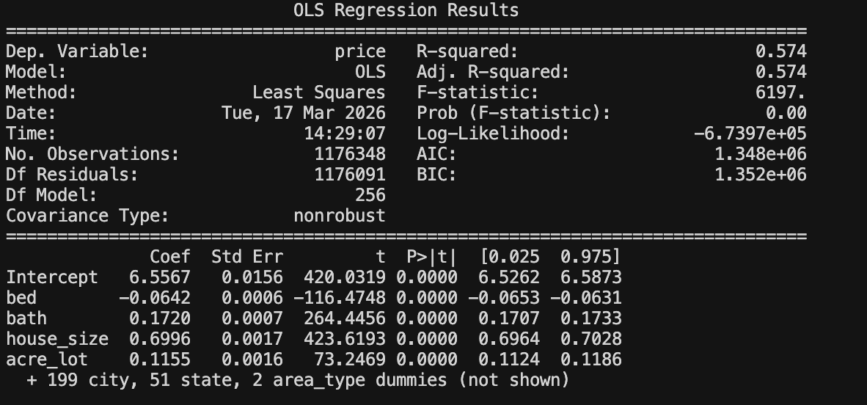
Appendix 3: OLS Results

Slide 15
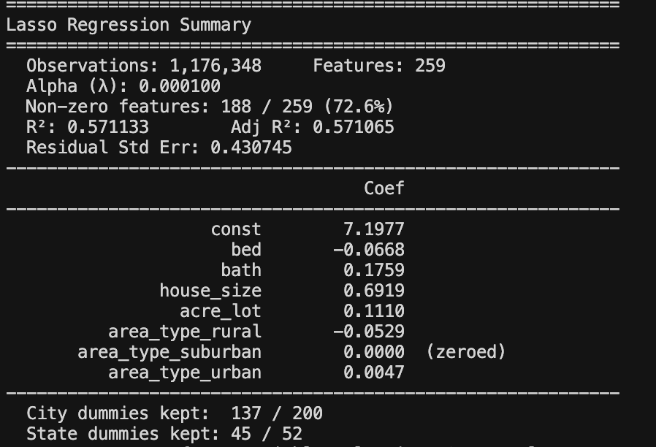
Appendix 4: LASSO Results

Slide 16
Reference
Hjort, A., Pensar, J., Scheel, I., & Sommervoll, D. E. (2022). House price prediction with gradient boosted trees under different loss functions. Journal of Property Research, 39(4), 338-364.
Rosen, S. (1974). Hedonic prices and implicit markets: product differentiation in pure competition. Journal of political economy, 82(1), 34-55.
Sharma, H., Harsora, H., & Ogunleye, B. (2024). An optimal house price prediction algorithm: XGBoost. Analytics, 3(1), 30-45.

